Slide 1
Managing State
Chapter 13

Slide 2
Objectives
1
2
The Problem of State
Passing Information via Query Strings
3
4
Passing Information via the URL Path
Cookies
5
6
Serialization
Session State
7
8
7
HTML5 Web Storage
Caching

Slide 3
The Problem Of State In Web Applications
Section 1 of 8

Slide 4
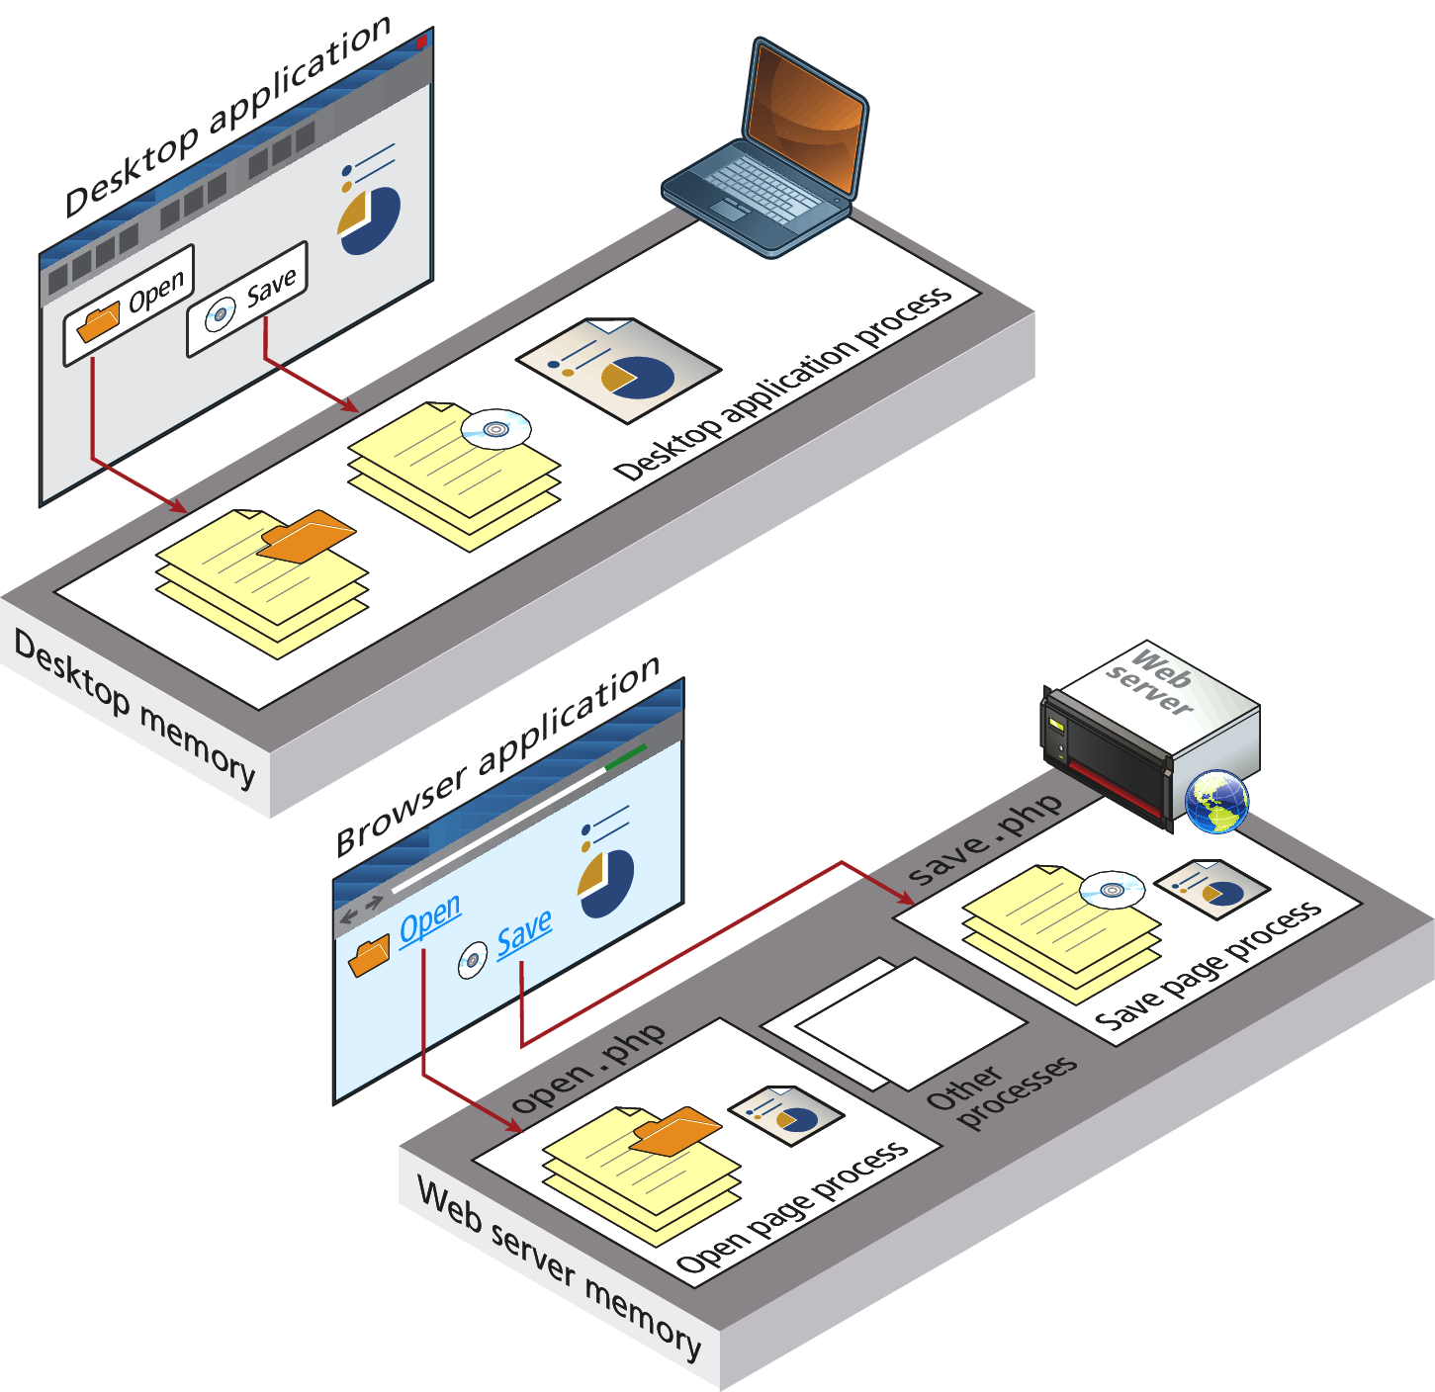
State in Web Applications
Not like a desktop application

Slide 5
State in Web Applications
Not like a desktop application
Unlike the unified single process that is the typical desktop application, a web application consists of a series of disconnected HTTP requests to a web server where each request for a server page is essentially a request to run a separate program.
The HTTP protocol does not, without programming intervention, distinguish two requests by one source from two requests from two different sources

Slide 6
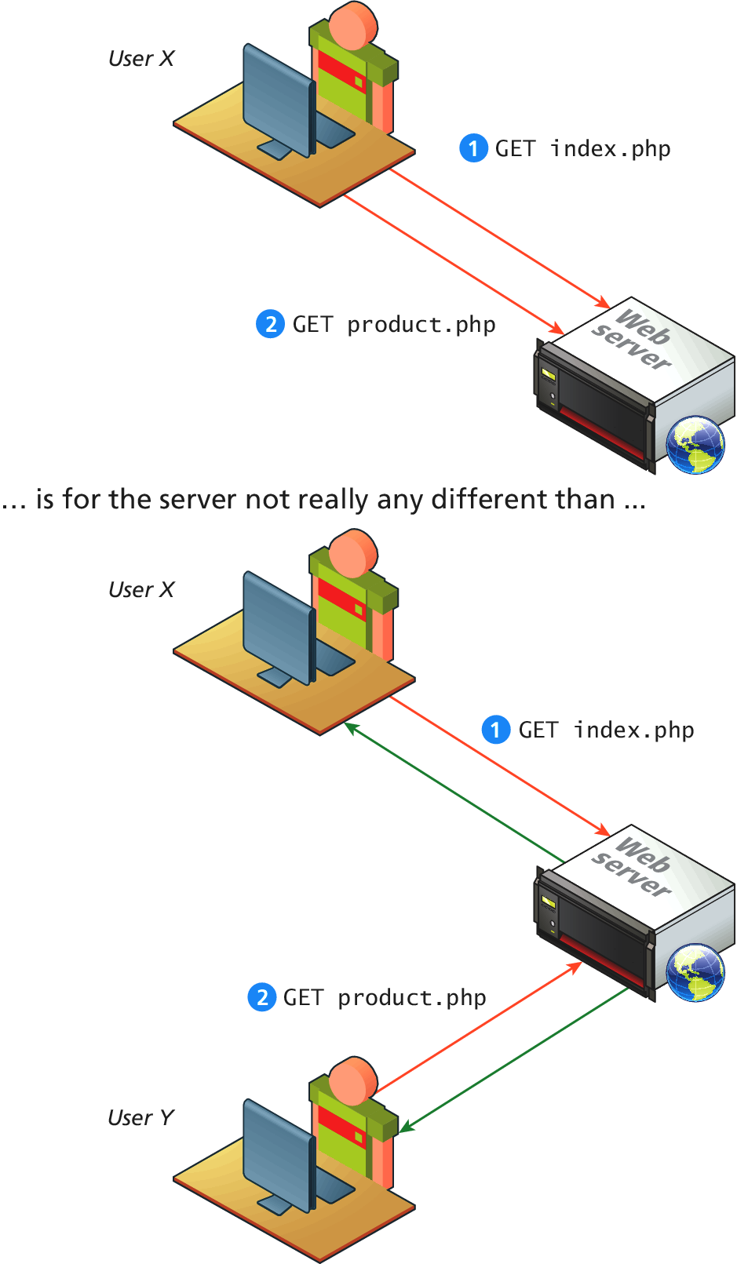
State in Web Applications
What’s the issue?

Slide 7
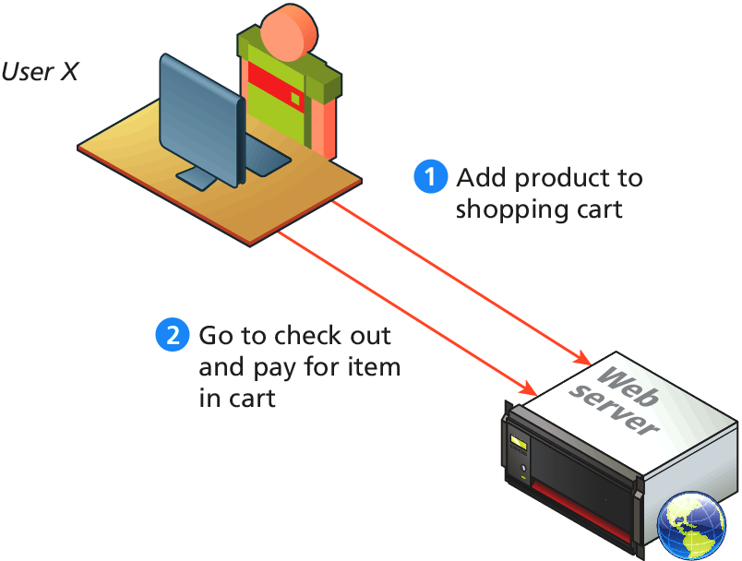
State in Web Applications
What’s the desired outcome

Slide 8
State in Web Applications
How do we reach our desired outcome?
What mechanisms are available within HTTP to pass information to the server in our requests?
In HTTP, we can pass information using:
Query strings
Cookies

Slide 9
Passing Information via Query Strings
Section 2 of 8

Slide 10
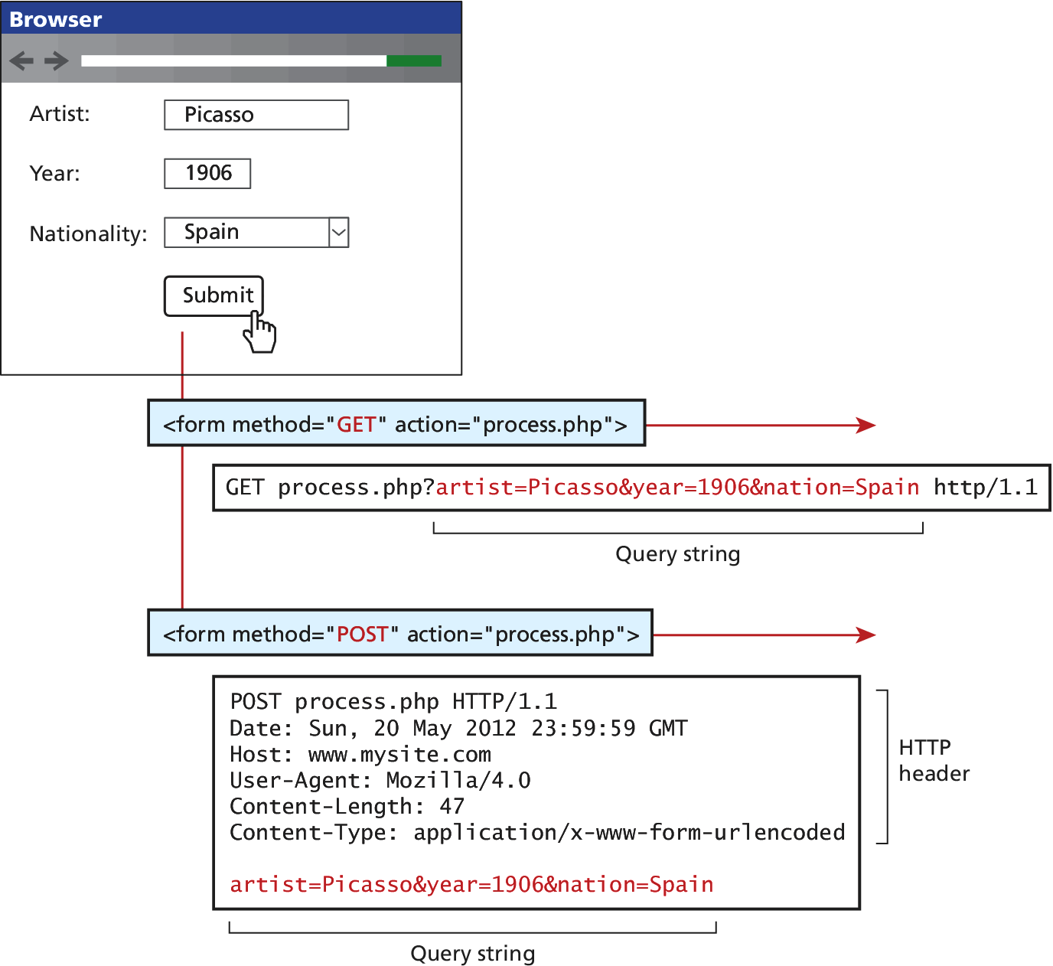
Info in Query Strings
Recall GET and POST

Slide 11
Passing Information via the URL Path
Section 3 of 8

Slide 12
Passing Info via URL Path
An Idealized looking link structure
Dynamic URLs (i.e., query string parameters) are a pretty essential part of web application development.
How can we do without them?
The answer is to rewrite the dynamic URL into a static one (and vice versa). This process is commonly called URL rewriting.

Slide 13
URL rewriting
Search Engine (Fine… and Human) Friendly
We can try doing our own rewriting. Let us begin with the following URL with its query string information:
www.somedomain.com/DisplayArtist.php?artist=16
One typical alternate approach would be to rewrite the URL to:
www.somedomain.com/artists/16.php
Notice that the query string name and value have been turned into path names. One could improve this to make it more SEO friendly using the following:
www.somedomain.com/artists/Mary-Cassatt

Slide 14
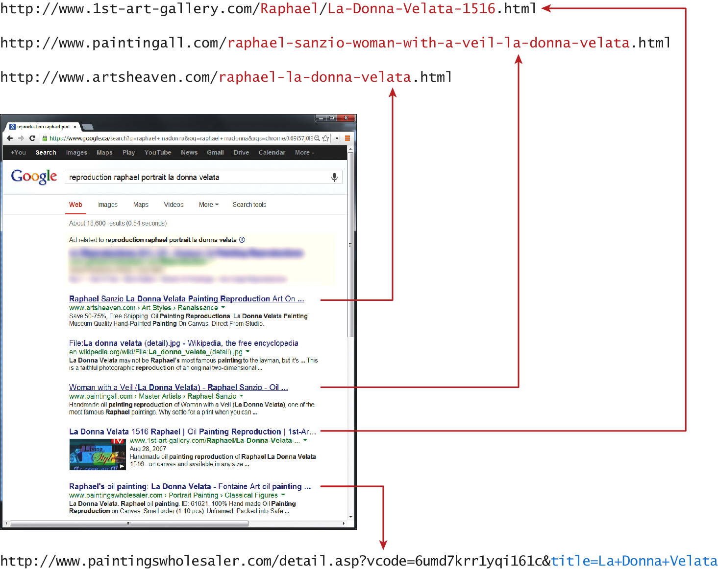
URL rewriting
Search Engine (Fine… and Human) Friendly

Slide 15
URL rewriting in Apache
You are not yet ready grasshoper
The mod_rewrite module uses a rule-based rewriting engine that utilizes Perl compatible regular expressions to change the URLs so that the requested URL can be mapped or redirected to another URL internally.
Look in Chapter 19 for details on Apache and URL rewriting.

Slide 16
URL rewriting in Apache
You are not yet ready grasshoper
The mod_rewrite module uses a rule-based rewriting engine that utilizes Perl compatible regular expressions to change the URLs so that the requested URL can be mapped or redirected to another URL internally.
Look in Chapter 19 for details on Apache and URL rewriting.

Slide 17
Cookies
Section 4 of 8

Slide 18
Cookies
mmmm
Cookies are a client-side approach for persisting state information.
They are name=value pairs that are saved within one or more text files that are managed by the browser.

Slide 19
Cookies
How do they Work?
While cookie information is stored and retrieved by the browser, the information in a cookie travels within the HTTP header.
Sites that use cookies should not depend on their availability for critical features
The user can delete cookies or tamper with them

Slide 20
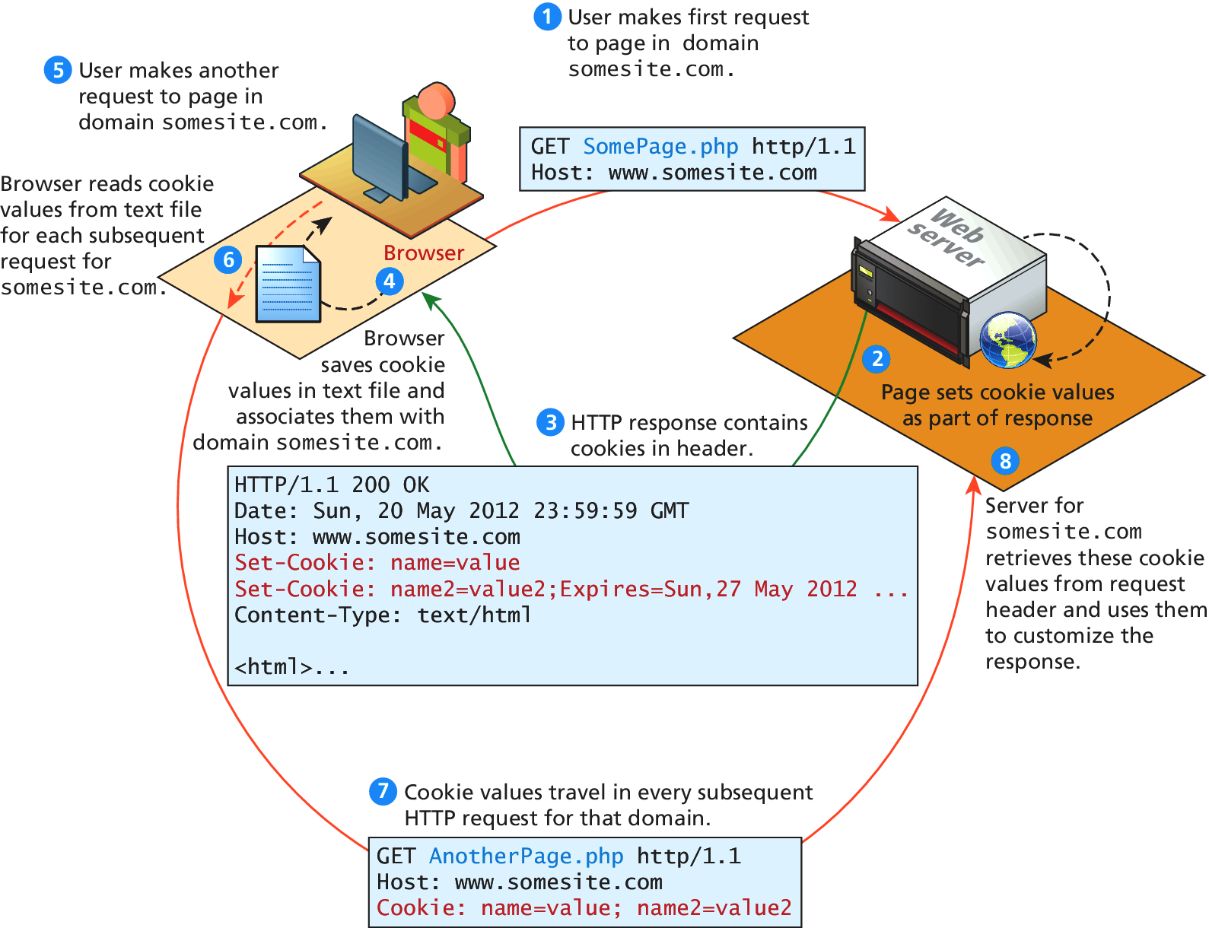
Cookies
How do they Work?

Slide 21
Cookies
Chocolate and peanut butter
Two kinds of Cookie
A session cookie has no expiry stated and thus will be deleted at the end of the user browsing session.
Persistent cookies have an expiry date specified;

Slide 22
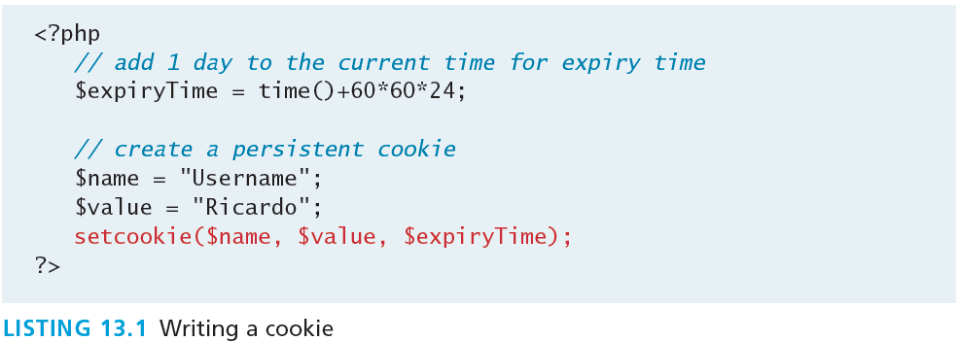
Using Cookies
Writing a cookie
It is important to note that cookies must be written before any other page output.

Slide 23
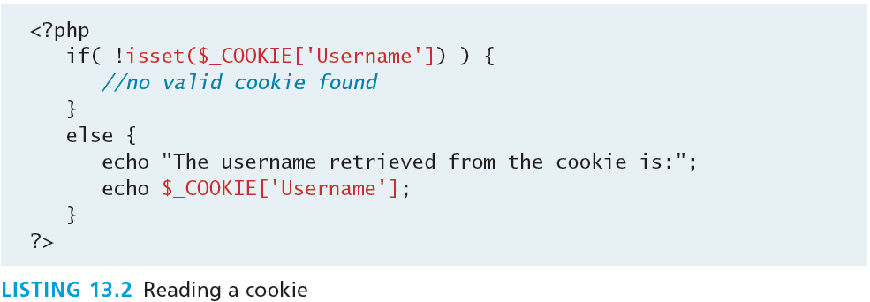
Using Cookies
Reading a cookie

Slide 24
Using Cookies
Common usages
In addition to being used to track authenticated users and shopping carts, cookies can implement:
“Remember me” persistent cookie
Store user preferences
Track a user’s browsing behavior

Slide 25
Serialization
Section 5 of 8

Slide 26
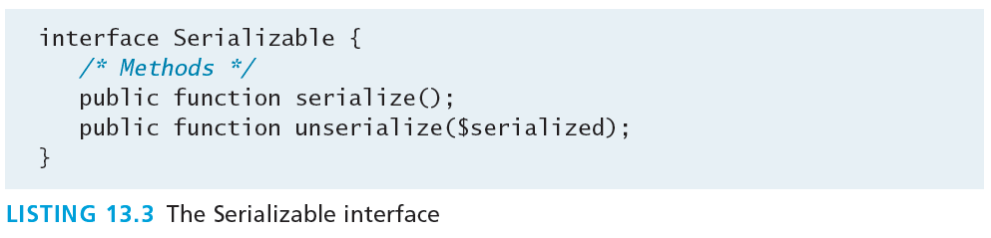
Serialization
Down to 0s and 1s
Serialization is the process of taking a complicated object and reducing it a string representation for either storage or transmission.
In PHP objects can easily be reduced down to a string using the serialize() function.
The string can be reconstituted back into an object using the unserialize() method

Slide 27
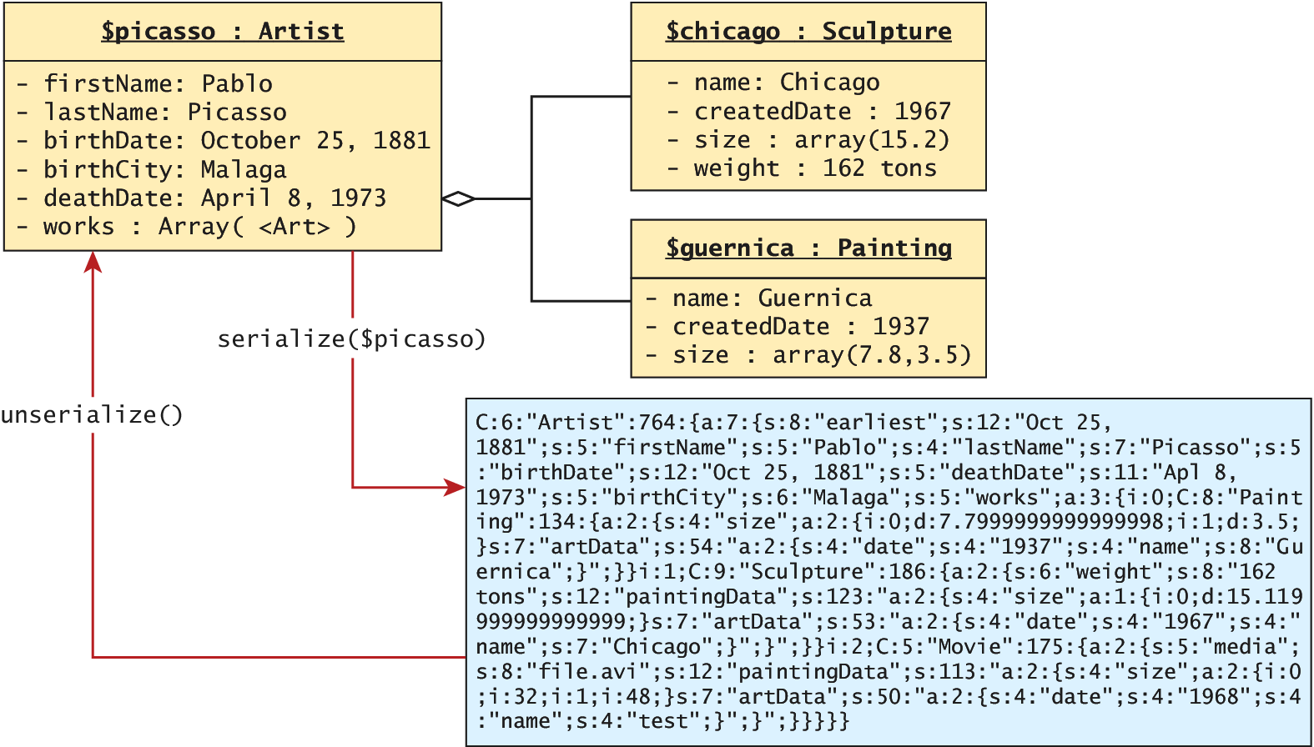
Serialization
Serialization and deserialization

Slide 28
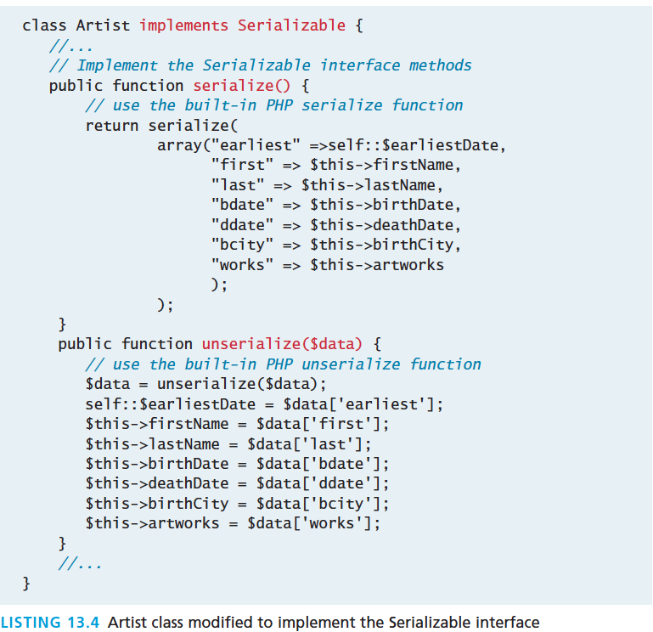
Serialization
Consider our Artist class

Slide 29
Serialization
Consider our Artist class
The output of calling serialize($picasso) is:
C:6:"Artist":764:{a:7:{s:8:"earliest";s:13:"Oct 25, 1881";s:5:"firstName";s:5:"Pablo";s:4:"lastName";s:7:"Picasso";s:5:"birthDate";s:13:"Oct 25, 1881";s:5:"deathDate";s:11:"Apl 8, 1973";s:5:"birthCity”;s:6:"Malaga";s:5:"works"; a:3:{i:0;C:8:"Painting":134:{a:2:{s:4:"size”;a:2:{i:0;d:7.7999999999999998;i:1;d:3.5;}s:7:"artData";s:54:"a:2:{s:4:"date";s:4:"1937";s:4:"name";s:8:"Guernica";}";}}i:1;C:9:"Sculpture”:186:{a:2:{s:6:"weight";s:8:"162 tons";s:13:"paintingData"; s:133:"a:2:{s:4:"size";a:1:{i:0;d:15.119999999999999;}s:7:"artData";s:53:”a:2:{s:4:"date";s:4:"1967";s:4:"name";s:7:"Chicago";}";}";}}i:2;C:5:"Movie":175:{a:2:{s:5:"media";s:8:"file.avi";s:13:"paintingData";s:113:"a:2:{s:4:"size";a:2:{i:0;i:32;i:1;i:48;}s:7:"artData";s:50:"a:2:{s:4:"date";s:4:"1968";s:4:"name";s:4:"test";}";}";}}}}}
If the data above is assigned to $data, then the following line will instantiate a new object identical to the original:
$picassoClone = unserialize($data);

Slide 30
Application of Serialization
Remember our state problem
Since each request from the user requires objects to be reconstituted, using serialization to store and retrieve objects can be a rapid way to maintain state between requests.
At the end of a request you store the state in a serialized form, and then the next request would begin by deserializing it to reestablish the previous state.

Slide 31
Session State
Section 6 of 8

Slide 32
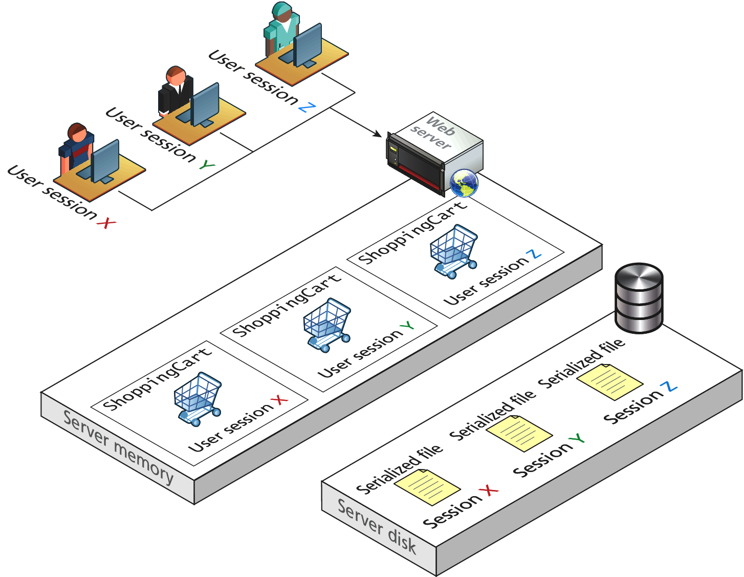
Session State
Visual

Slide 33
Session State
All modern web development environments provide some type of session state mechanism.
Session state is a server-based state mechanism that lets web applications store and retrieve objects of any type for each unique user session.
Session state is ideal for storing more complex objects or data structures that are associated with a user session.
In PHP, session state is available to the via the $_SESSION variable
Must use session_start() to enable sessions.

Slide 34
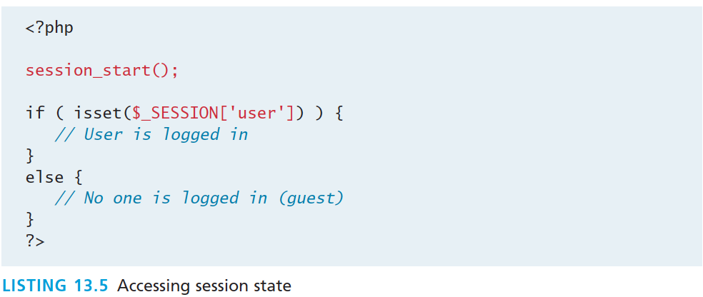
Session State
Accessing State

Slide 35
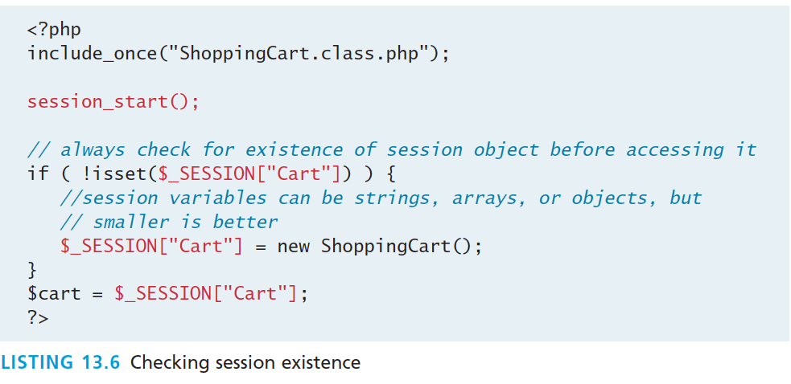
Session State
Checking Session existance

Slide 36
Session State
Checking Session existence

Slide 37
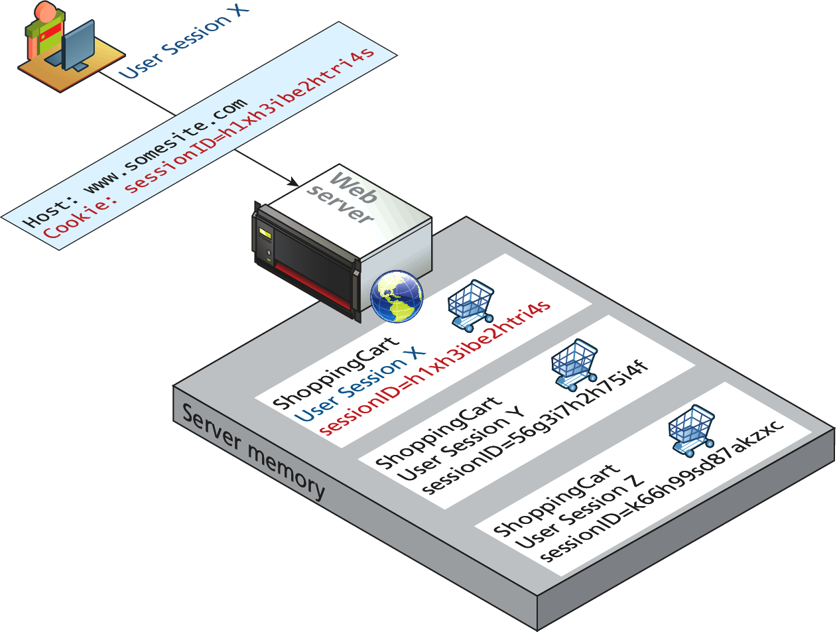
How does state session work?
It’s magic right?
Sessions in PHP are identified with a unique 32-byte session ID.
This is transmitted back and forth between the user and the server via a session cookie

Slide 38
How does state session work?
It’s magic right?
For a brand new session, PHP assigns an initially empty dictionary-style collection that can be used to hold any state values for this session.
When the request processing is finished, the session state is saved to some type of state storage mechanism, called a session state provider
When a new request is received for an already existing session, the session’s dictionary collection is filled with the previously saved session data from the session state provider.

Slide 39
Session Storage
It is possible to configure many aspects of sessions including where the session files are saved.
The decision to save sessions to files rather than in memory (like ASP.NET) addresses the issue of memory usage that can occur on shared hosts as well as persistence between restarts.
Inexpensive web hosts may sometimes stuff hundreds or even thousands of sites on each machine.
Server memory may be storing not only session information, but pages being executed, and caching information

Slide 40
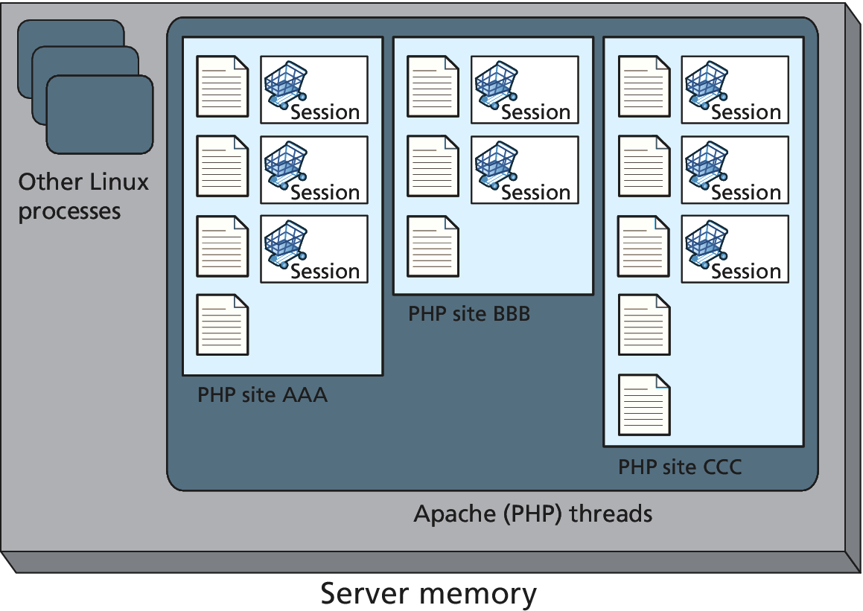
Session Storage
Applications and Server Memory

Slide 41
Session Storage
High Volume considerations
Higher-volume web applications often run in an environment in which multiple web servers (also called a web farm) are servicing requests.
In such a situation the in-process session state will not work, since one server may service one request for a particular session, and then a completely different server may service the next request for that session

Slide 42
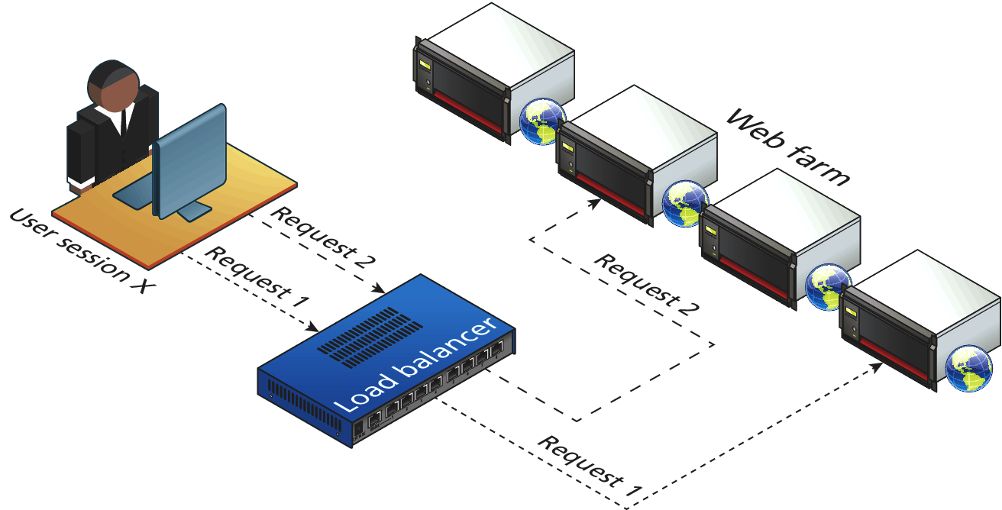
Session Storage
Web Farm Sessions: Visualizing the problem

Slide 43
Session Storage
Visualizing the problem
There are effectively two categories of solution to this problem.
Configure the load balancer to be “session aware” and relate all requests using a session to the same server.
Use a shared location to store sessions, either in a database, memcache, or some other shared session state mechanism

Slide 44
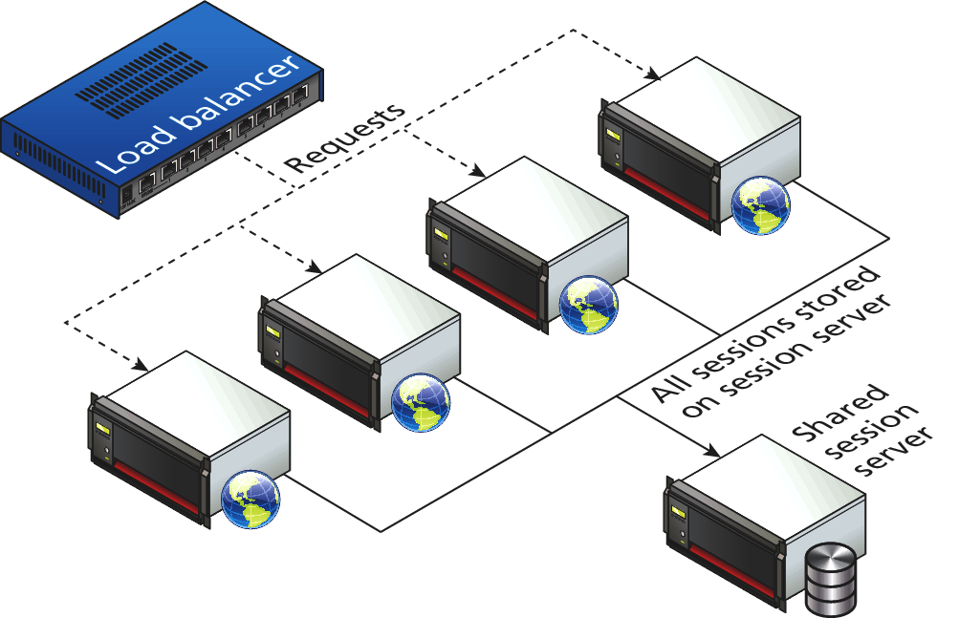
Session Storage
Shared location with memcache

Slide 45
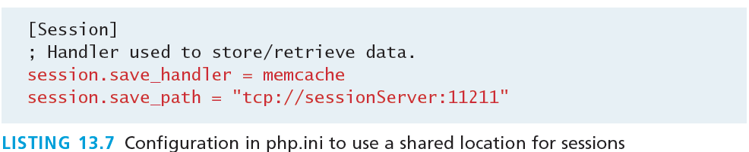
Session Storage
Shared location configuration in php.ini (on each webserver)

Slide 46
HTML5 Web Storage
Section 7 of 8

Slide 47
Web Storage
HTML5 only
Web storage is a new JavaScript-only API introduced in HTML5.4
It is meant to be a replacement (or perhaps supplement) to cookies, in that web storage is managed by the browser;
unlike cookies, web storage data is not transported to and from the server with every request and response.
In addition, web storage is not limited to the 4K size barrier of cookies;

Slide 48
Web Storage
Two types
Just as there were two types of cookies, there are two types of global web storage:
The localStorage object is for saving information that will persist between browser sessions.
The sessionStorage object is for information that will be lost once the browser session is finished.

Slide 49
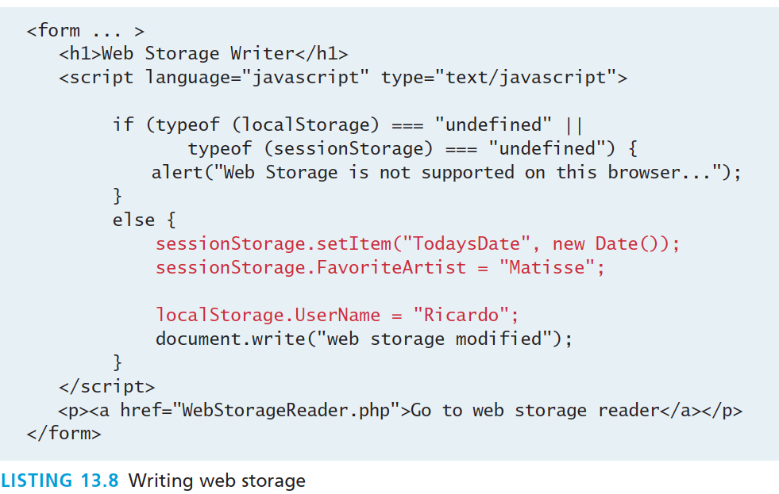
Using Web Storage
JavaScript code for writing information to web storage

Slide 50
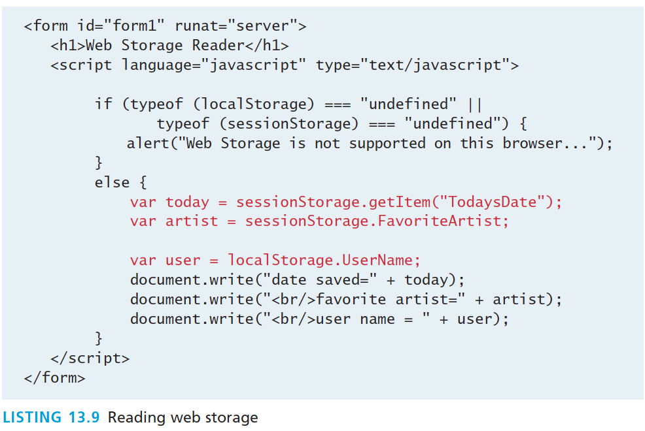
Using Web Storage
JavaScript code for reading information from web storage

Slide 51
Using Web Storage
Why would you do it?
A better way to think about web storage is not as a cookie replacement but as a local cache for relatively static items available to JavaScript
One practical use of web storage is to store static content downloaded asynchronously such as XML or JSON from a web service in web storage, thus reducing server load for subsequent requests by the session.

Slide 52
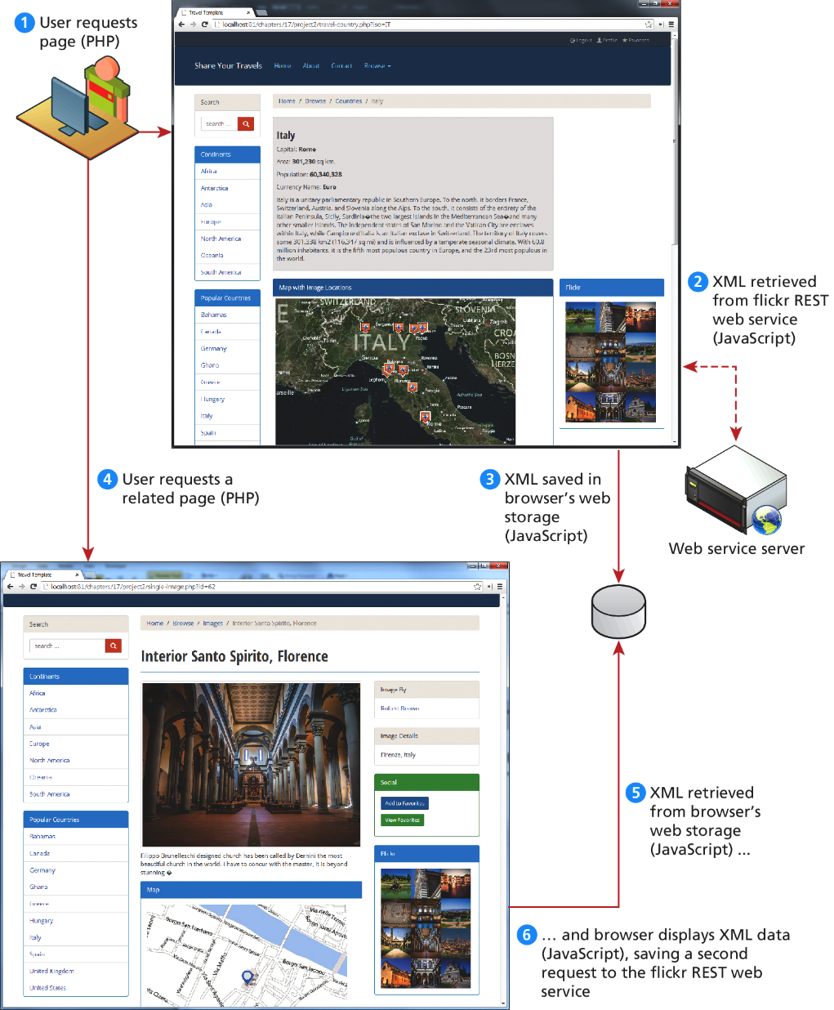
Using Web Storage
How would you do it?

Slide 53
Caching
Section 8 of 8

Slide 54
Caching
What’s it good for
Every time a PHP page is requested, it must be fetched, parsed, and executed by the PHP engine. For the typical PHP page, this might also involve numerous database queries and processing to build.
If this page is being served thousands of times per second, the dynamic generation of that page may become unsustainable.
One way to address this problem is to cache the generated markup in server memory so that subsequent requests can be served from memory rather than from the execution of the page.

Slide 55
Page Output Caching
Cache the whole page
In this type of caching, the contents of the rendered PHP page (or just parts of it) are written to disk for fast retrieval

Slide 56
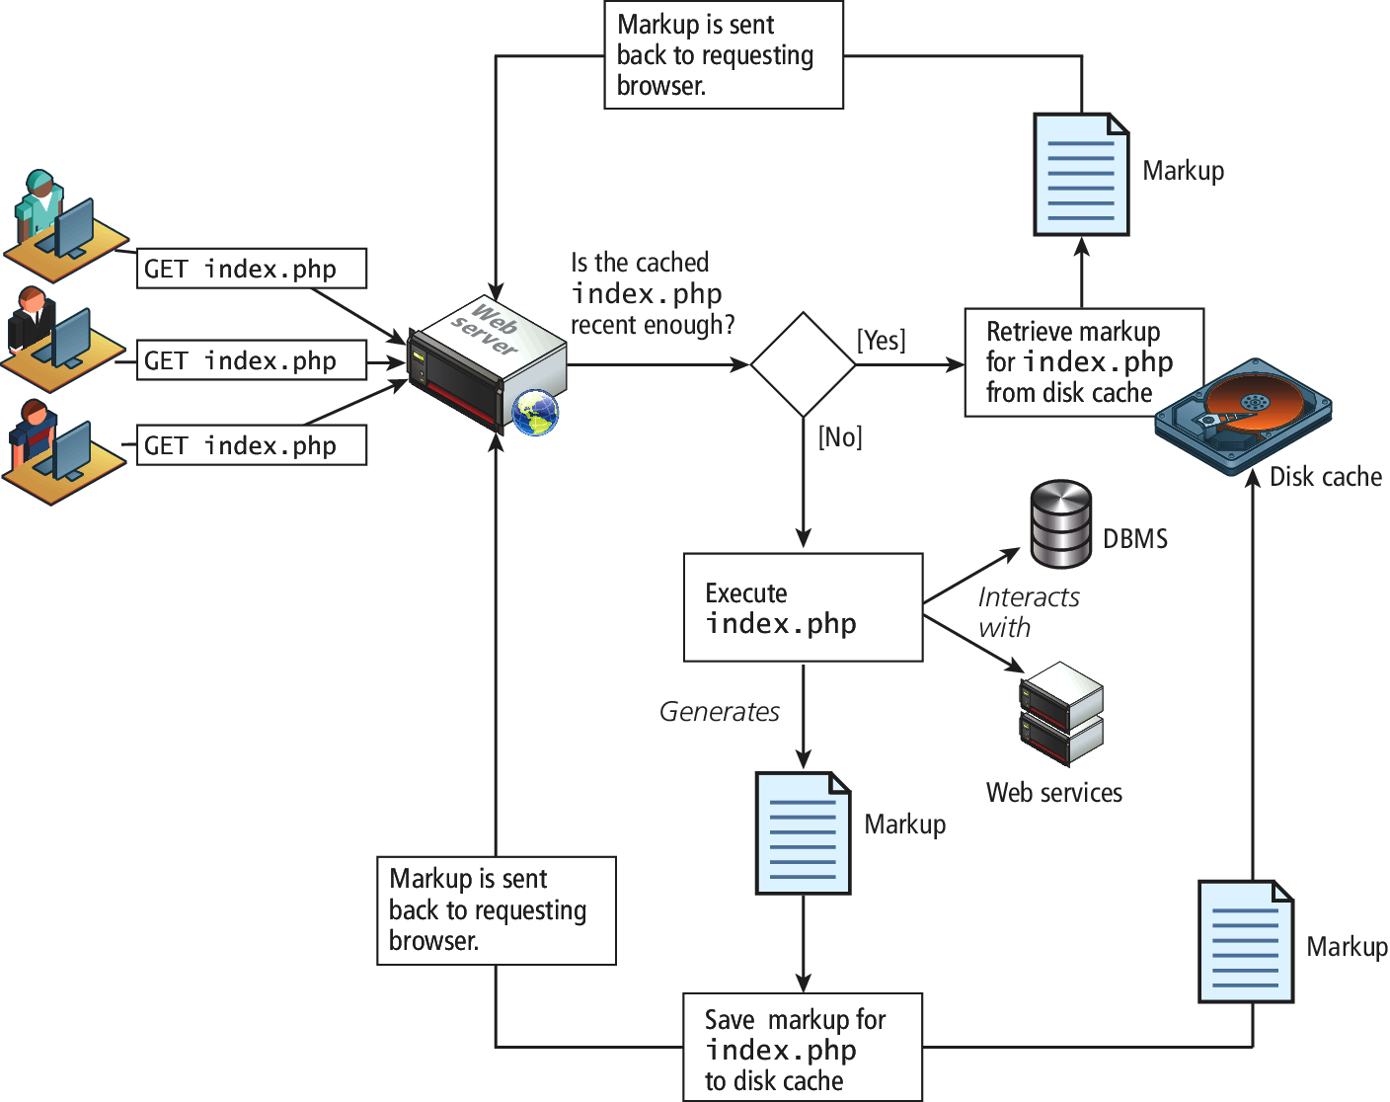
Page Output Caching
Cache the whole page

Slide 57
Application Data Caching
Can’t always cache the whole page
Many sites customize the content on each page for each user, so full or partial page caching may not always be possible.
An alternate strategy is to use application data caching in which a page will programmatically place commonly used collections of data into cache memory, and then other pages that also need that same data can use the cache version rather than re-retrieve it from its original location

Slide 58
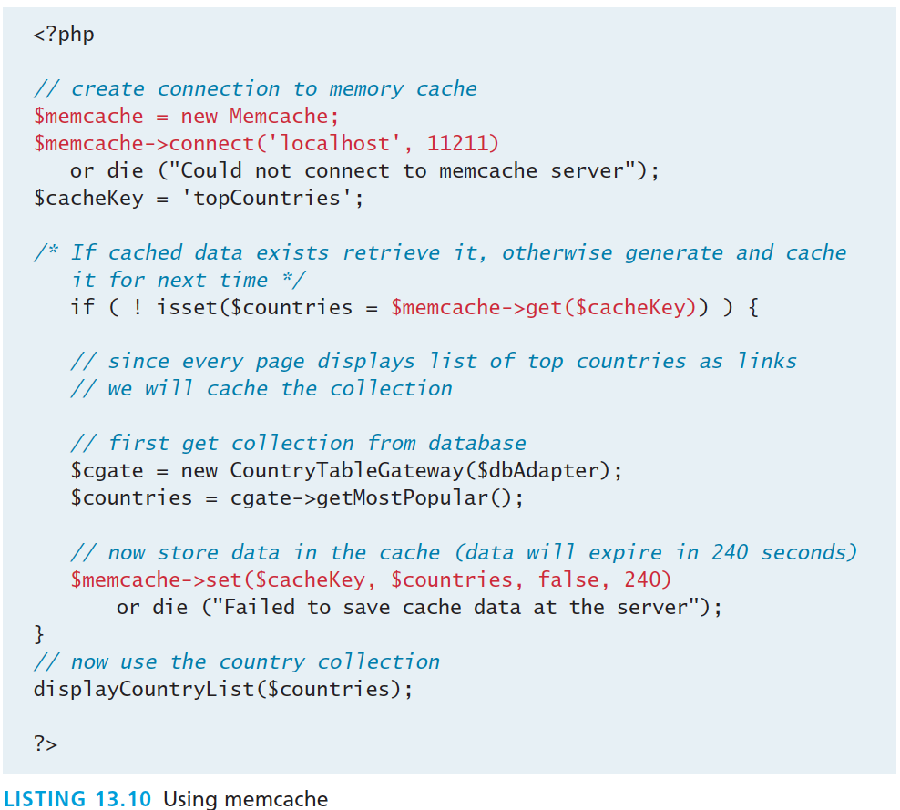
Application Data Caching
Can’t always cache the whole page

Slide 59
What You’ve Learned
1
2
The Problem of State
Passing Information via Query Strings
3
4
Passing Information via the URL Path
Cookies
5
6
Serialization
Session State
7
8
7
HTML5 Web Storage
Caching

